Slide 1




CODECLAUSE
Virtual Internship
Welcome to the CODECLAUSE Internship program! We offer a unique opportunity for students to gain practical experience in software development.
Suraj Gupta
2201331720064

Slide 2

About CODECLAUSE
CODECLAUSE is a leading software development company with a mission to deliver innovative solutions.
We specialize in cutting-edge technologies, including cloud computing, artificial intelligence, and machine learning.
Our vision is to empower businesses through transformative technology.
History
Mission
Founded in 2015, CODECLAUSE has grown rapidly.
To provide exceptional software solutions.
Technology
Vision
We leverage the latest technologies.
To be a global leader in software innovation.

Slide 3

Internship Objectives
This internship aims to equip students with practical skills.
Interns will gain real-world experience and develop valuable knowledge.
1
Objectives
Develop technical skills in software development.
2
Goals
Contribute to real-world projects.
3
Projects
Employee Management System and Face Authentication.

Slide 4
Key Responsibilities
Interns will be involved in all stages of the development process.
They will work closely with experienced developers and contribute to team projects.
Design and Development
Testing and Debugging
Documentation
Develop software components and features.
Ensure code quality and functionality.
Create clear and concise documentation.

Slide 5

Project Details
Interns will work on two main projects.
These projects are designed to provide practical experience in real-world applications.
Project
Description
Employee Management System
A web application for managing employee records.
Face Authentication
A system for verifying user identity using facial recognition.

Slide 6
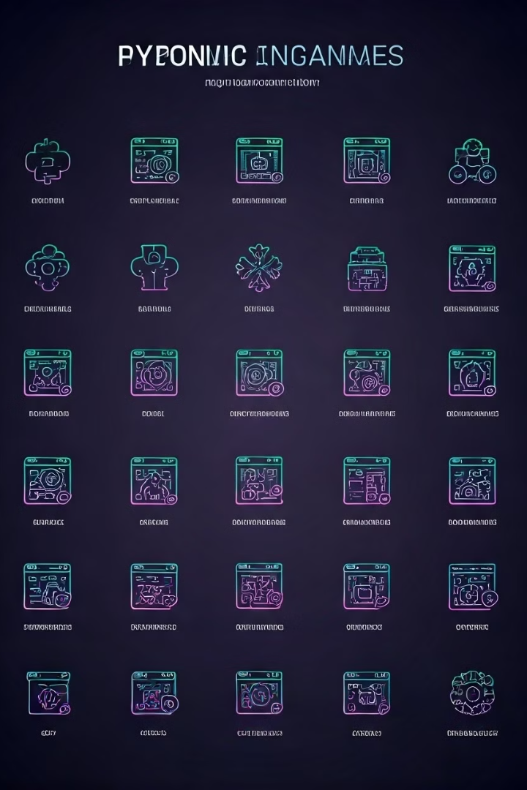
Skills Required
Interns should have a strong foundation in software development.
They should be familiar with core concepts and programming languages.
1
Programming Languages
2
Databases
SQL or NoSQL databases.
Python, Java, JavaScript,
3
Web Development Frameworks
4
Version Control Systems
React, Angular,
Git or similar.

Slide 7




Challenges Faced
Interns may encounter challenges during the internship.
These challenges are opportunities for learning and growth.
Technical Challenges
Debugging code, optimizing performance, and overcoming technical hurdles.
Communication Challenges
Collaborating effectively with team members and stakeholders.
Time Management Challenges
Managing time effectively and meeting deadlines.

Slide 8





Career Growth Opportunities
The internship offers opportunities for career growth.
Interns will gain valuable experience that can lead to future job prospects.
Certification
Networking
Job Opportunities
Personal Growth
Potential for industry certifications upon successful completion.
Build connections with industry professionals and mentors.
Possibility of full-time employment at CODECLAUSE or other companies.
Develop essential skills and gain valuable experience.

Slide 9

Conclusion and Future
The CODECLAUSE Internship program is a valuable experience for students.
We encourage you to join us and embark on a journey of learning and growth.
We look forward to shaping the future of technology together.

Slide 10

THANK YOU
Q&A
We are happy to answer any questions you may have.
Please feel free to ask.

